Slide 1
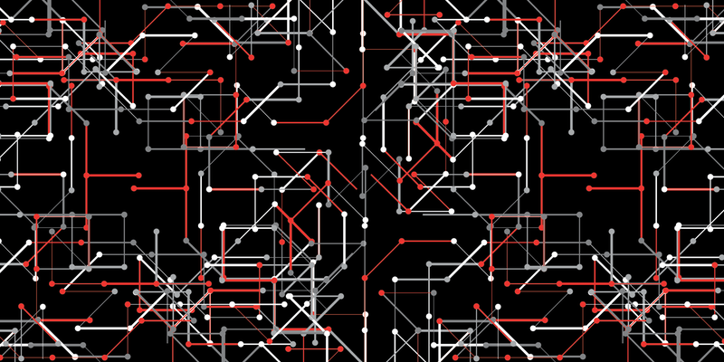
FPGA 101 -Workshop
HACKADAY BELGRADE 26th MAY 2018
Miodrag Milanović

Slide 2

Introduction
Engineer
Hardware and emulation enthusiast
Software developer since year 2000
Software architect at “Levi Nine” Serbia
Worked in C,C++,C# and Java
Working on MAME emulation project since 2006
Gave few talks related to FPGA targeting software developers.

Slide 3
THANKS
Jan Dolinaj – for helping making these boards
David Shah – for great help in designing boards
Grant Jennings and Lattice – for Upduino 2 board and support
OSH Park and Drew Fustini – for sponsoring PCB production
IcoTC and Clifford Wolf – for excellent tools and logistic support for project
Jesús Arroyo Torrens and Juan González for APIO and IceStudio
Risc-V and MicroPython community
Hackaday for creating this great event

Slide 4
WHAT WE ARE GOING TO LEARN ?
What is FPGA and how it works
How to use visual design tools to create hardware solutions
Verilog basics
How to create audio and video
Create CPU
Use existing Risc-V CPU core and run C programs on it
Run MicroPython on FPGA and program directly on it
And much more …

Slide 5
Approach

Slide 6
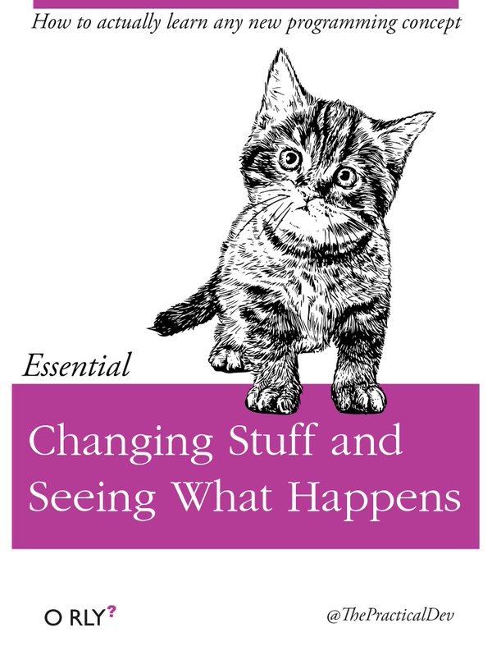

Slide 7


Slide 8
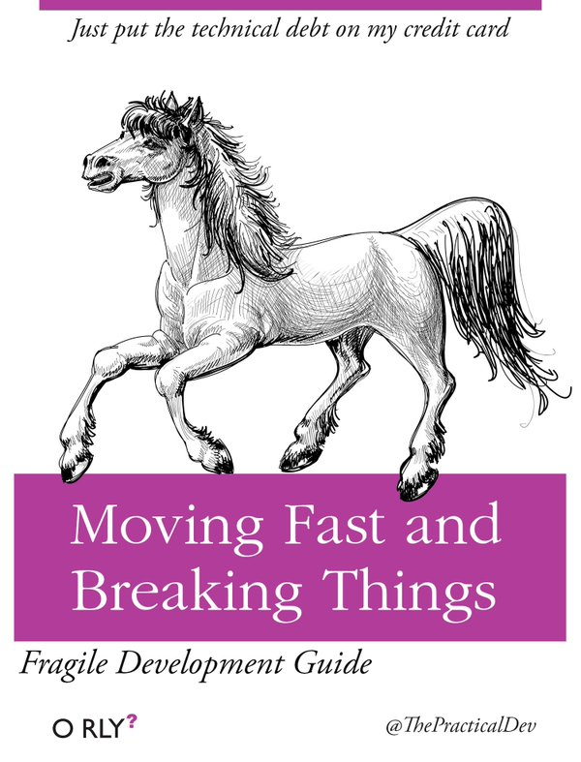

Slide 9
LET’s START

Slide 10
Logic LEVELS
1
0
X
Z

Slide 11
Boolean operations
INPUT |  | OUTPUT
A | B | A AND B | A NAND B | A OR B | A NOR B | A NOR B | A XNOR B
0 | 0 | 0 | 1 | 0 | 1 | 0 | 1
0 | 1 | 0 | 1 | 1 | 0 | 1 | 0
1 | 0 | 0 | 1 | 1 | 0 | 1 | 0
1 | 1 | 1 | 0 | 1 | 0 | 0 | 1
AND
OR
XOR
NOT
NAND
NOR
XNOR

Slide 12
D Flip-Flop
CLK | D | R | S | Q | !Q
rising edge | 0 | 0 | 0 | 0 | 1
rising edge | 1 | 0 | 0 | 1 | 0
falling edge | x | 0 | 0 | Q | !Q
x | x | 1 | 0 | 0 | 1
x | x | 0 | 1 | 1 | 0
x | x | 1 | 1 | 1 | 1
D
Q
CLK
!Q
Falling edge
Rising edge
CLK

Slide 13
What is FPGA ?
Field-programmable gate array
Logic block – LUT + D Flip-Flop + full adder
I/O block – one per each pin
Interconnections, clock tree
Hard block – Block RAM, multipliers, DSP, CPU,…
Vendors: Xilinx, Intel/Altera, Lattice, Microsemi …

Slide 14
Logic block
Carry in
LUT
Full
Adder
D
Flip-Flop
MUX
Input
MUX
Output
MUX
Carry out
Clock

Slide 15
How do we program FPGA ?
HDL - Hardware description language
VHDL and Verilog
Analysis: parsing and validation of HDL
Synthesis: HDL -> netlist
Place-and-route: netlist -> specific FPGA technology
Assembler: specific FPGA technology -> bitstream
Programming: deploying bitstream on device (serial flash memory or directly)
Timing analysis
Simulation

Slide 16
Open source tools
Yosys - Verilog synthesis tool by Clifford Wolf
Arachne PnR - Place and route tool by Cotton Seed
Project IceStorm – Assembler, time analysis and FPGA programming tool
by Clifford Wolf and Mathias Lasser
APIO – micro-ecosystem for open FPGAs by Jesús Arroyo Torrens and Juan González (Obijuan)
Icestudio - graphic editor for open FPGAs by Jesús Arroyo Torrens
Lattice iCE40 FPGA only

Slide 17
And more…
Icarus Verilog by Stephen Williams
Verilator by Wilson Snyder with Duane Galbi and Paul Wasson
FuseSoC - package manager and a set of build tools for FPGA/ASIC development by Olof Kindgren

Slide 18
LET’s SETUP

Slide 19
Install DRIVERS
apio drivers --ftdi-enable
apio system –lsftdi
Number of FTDI devices found: 1
Checking device: 0
Manufacturer: FTDI, Description: Single RS232-HS
apio system –lsserial
Number of Serial devices found: 1
COM3
Description: USB-SERIAL CH340 (COM3)
Hardware info: USB VID:PID=1A86:7523 SER=5 LOCATION=1-13

Slide 20
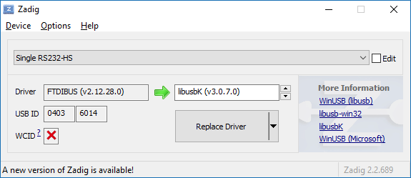
Windows update driver

Slide 21
Icestudio

Slide 22
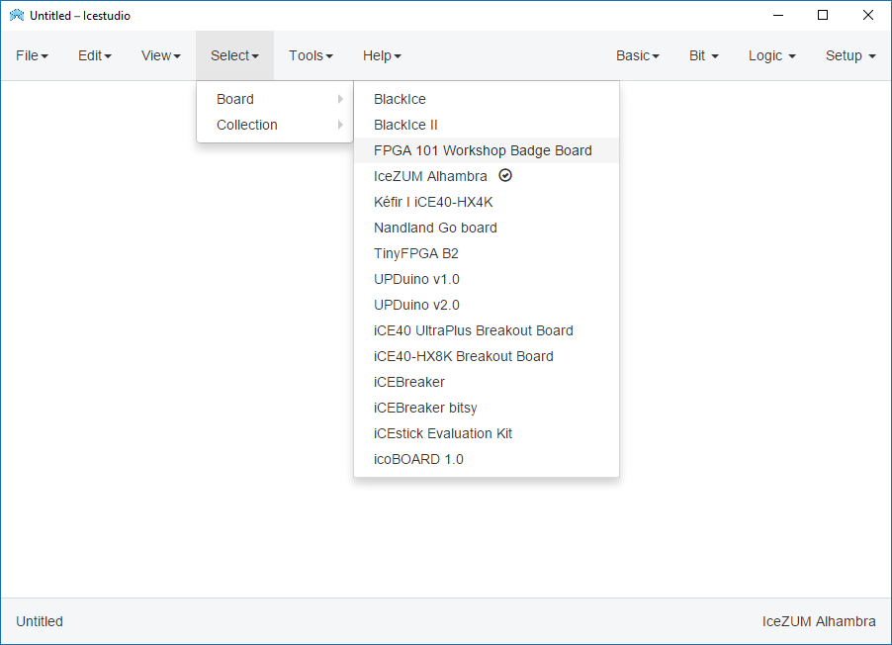

Slide 23
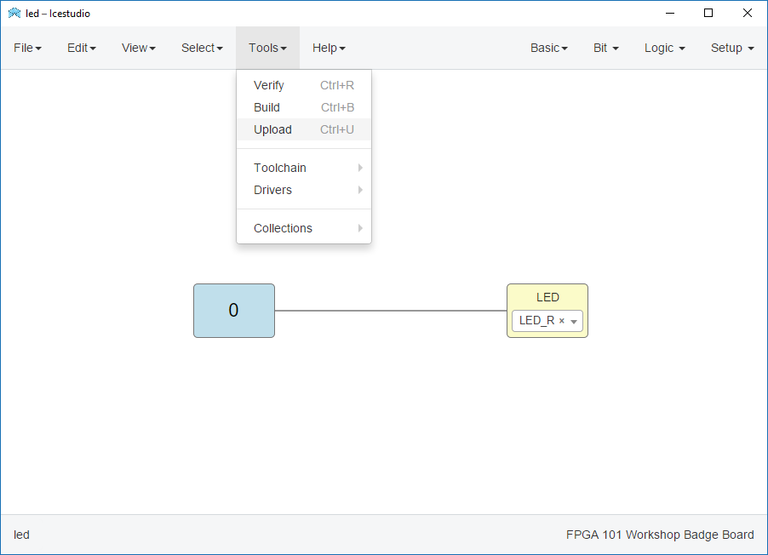

Slide 24
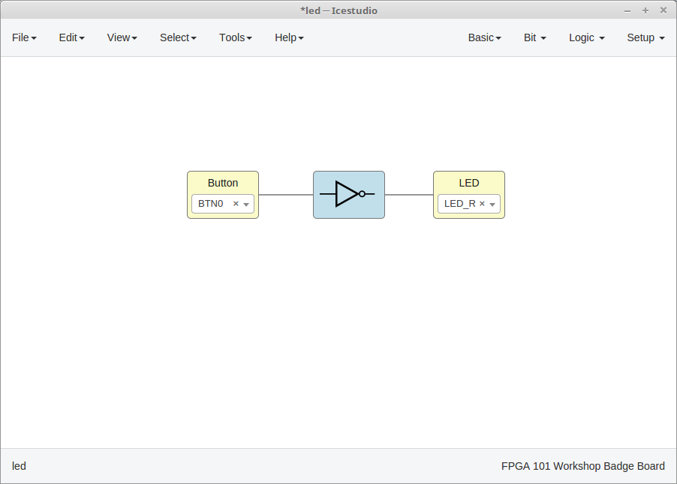

Slide 25
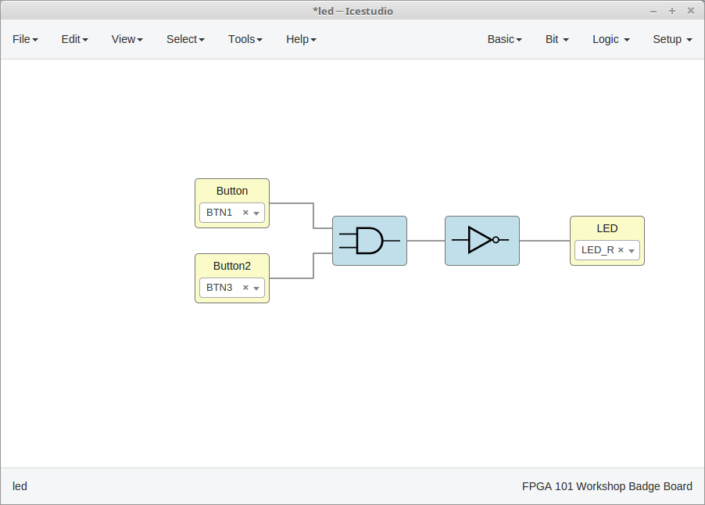

Slide 26
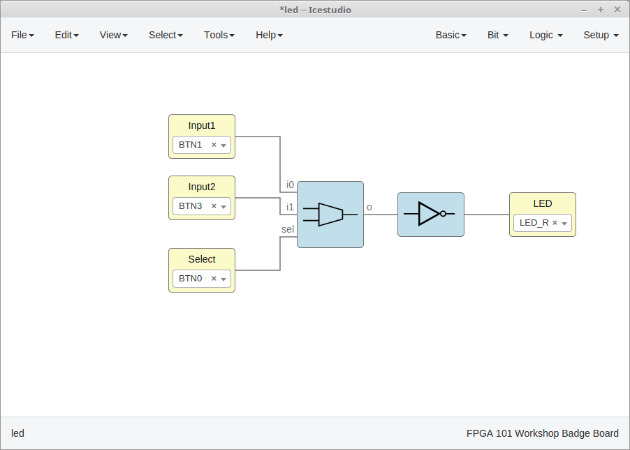

Slide 27
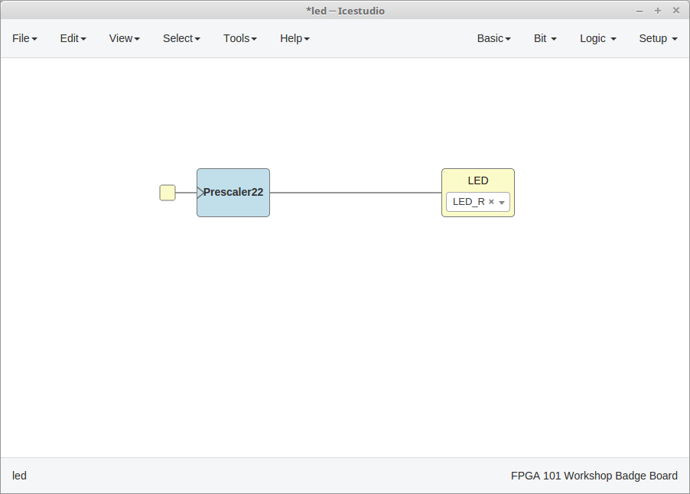

Slide 28
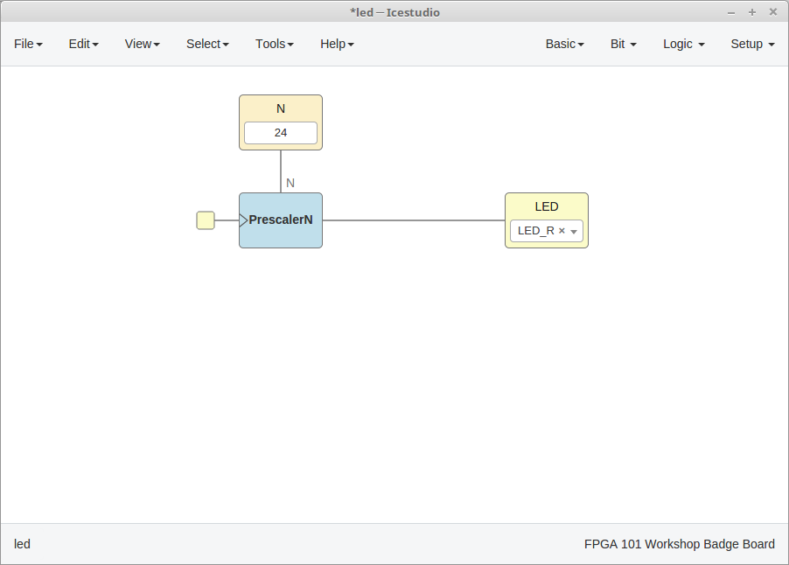

Slide 29
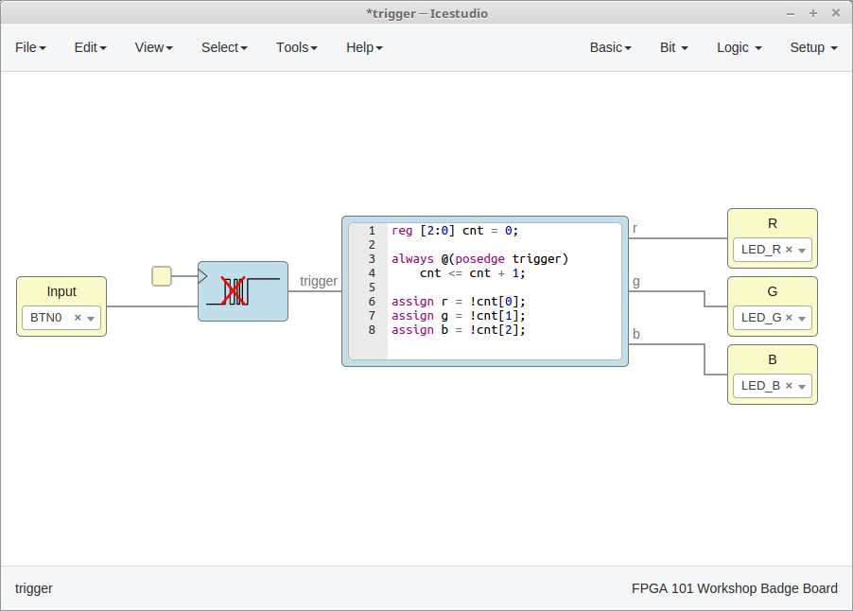

Slide 30
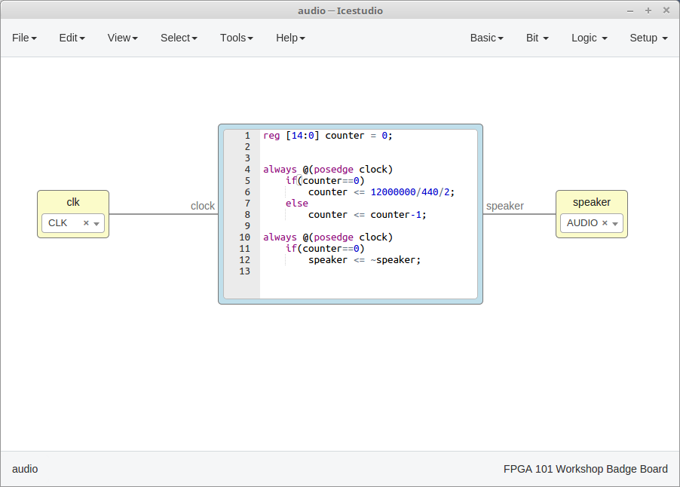

Slide 31
BASICS

Slide 32
CREATE APIO PROJECT
apio init --board fpga101
Creating apio.ini file ...
File 'apio.ini' has been successfully created!
[env]
board = fpga101

Slide 33
PCF FILE
# 12 MHz clock
set_io -nowarn CLK 35 # input
# LCD connector
set_io -nowarn LCD_CLK 18 # output
set_io -nowarn LCD_DEN 19 # output
set_io -nowarn LCD_VS 11 # output
set_io -nowarn LCD_HS 9 # output
set_io -nowarn LCD_RST 2 # output
set_io -nowarn LCD_D7 6 # output
set_io -nowarn LCD_D6 44 # output
set_io -nowarn LCD_D5 4 # output
set_io -nowarn LCD_D4 3 # output
set_io -nowarn LCD_D3 48 # output
set_io -nowarn LCD_D2 45 # output
set_io -nowarn LCD_D1 47 # output
set_io -nowarn LCD_D0 46 # output
set_io -nowarn LCD_PWM 13 # output
# Buttons
set_io -nowarn B0 23 # input
set_io -nowarn B1 25 # input
set_io -nowarn B2 26 # input
set_io -nowarn B3 27 # input
set_io -nowarn B4 21 # input
set_io -nowarn B5 12 # input
# Audio jack
set_io -nowarn AUDIO 37 # output
# PMOD connector
set_io -nowarn PMOD0 32
set_io -nowarn PMOD1 31
set_io -nowarn PMOD2 34
set_io -nowarn PMOD3 43
set_io -nowarn PMOD4 36
set_io -nowarn PMOD5 42
set_io -nowarn PMOD6 38
set_io -nowarn PMOD7 28
# RGB LED Driver
set_io -nowarn LED_G 39 # output
set_io -nowarn LED_B 40 # output
set_io -nowarn LED_R 41 # output

Slide 34
LED.V (VERILOG FILE)
module led (
output LED_B
);
assign LED_B = 1'b0;
endmodule

Slide 35
LED - COUNTER

Slide 36
COUNTER
module rgb (
input CLK,
output LED_R,
output LED_G,
output LED_B,
output LCD_PWM
);
assign LCD_PWM = 1'b0;
reg [32:0] clk_cnt;
initial
begin
clk_cnt = 0;
end
always @(posedge CLK)
begin
clk_cnt <= clk_cnt + 1;
end
assign LED_R = !clk_cnt[2];
assign LED_G = !clk_cnt[3];
assign LED_B = !clk_cnt[4];
endmodule

Slide 37
TEST BENCH
`timescale 1ns/1ps
module rgb_tb();
reg clk = 0;
wire led_r;
wire led_g;
wire led_b;
wire led_pwm;
rgb leds(.CLK(clk),.LED_R(led_r),.LED_G(led_g),
.LED_B(led_b),.LCD_PWM(led_pwm));
always
#(5) clk <= !clk;
initial
begin
$dumpfile("rgb_tb.vcd");
$dumpvars(0,rgb_tb);
#1000
$finish;
end
endmodule

Slide 38
APIO TOOLS
apio verify
iverilog -o hardware.out -D VCD_OUTPUT= "C:\msys64\opt\homedir\.apio\packages\toolchain-iverilog\vlib\cells_sim.v" rgb.v
========================= [SUCCESS] Took 0.30 seconds============================
apio lint
verilator --lint-only -IC:\msys64\opt\homedir\.apio\packages\toolchain-verilator\share rgb.v
========================= [SUCCESS] Took 0.21 seconds============================
apio sim
iverilog -o rgb_tb.out -D VCD_OUTPUT=rgb_tb "C:\msys64\opt\homedir\.apio\packages\toolchain-iverilog\vlib\cells_sim.v" rgb.v rgb_tb.v
vvp rgb_tb.out
VCD info: dumpfile rgb_tb.vcd opened for output.
gtkwave rgb_tb.vcd rgb_tb.gtkw

Slide 39
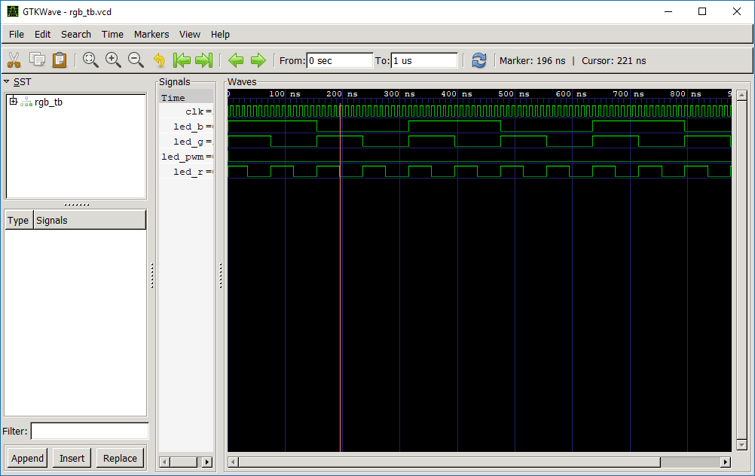

Slide 40
BUTTONS

Slide 41
DIRECT CONNECTION
module button_rgb (
input CLK,
output LED_R,
output LED_G,
output LED_B,
output LCD_PWM,
input B0,
input B1,
input B2
);
assign LCD_PWM = 1'b0;
assign LED_R = !B0;
assign LED_G = !B1;
assign LED_B = !B2;
endmodule

Slide 42
BUTTON AS TRIGGER
module button_cnt (
input CLK,
output LED_R,
output LED_G,
output LED_B,
output LCD_PWM,
input B0
);
reg [2:0] cnt = 0;
always @(posedge B0)
begin
cnt <= cnt + 1;
end
assign LCD_PWM = 1'b0;
assign LED_R = !cnt[0];
assign LED_G = !cnt[1];
assign LED_B = !cnt[2];
endmodule

Slide 43
BUTTON DEBOUNCER
module button_rgb (
input CLK, output LED_R, output LED_G, output LED_B,
output LCD_PWM, input B0
);
reg [24:0] clk_cnt;
reg [2:0] cnt = 0;
reg prev = 0;
always @(posedge CLK)
begin
clk_cnt <= clk_cnt + 1;
end
always @(posedge clk_cnt[20])
begin
prev <= B0;
if (prev == 1'b0 && B0 == 1'b1)
cnt <= cnt + 1;
end
assign LCD_PWM = 1'b0;
assign LED_R = !cnt[0];
assign LED_G = !cnt[1];
assign LED_B = !cnt[2];
endmodule

Slide 44
Exercise
Map different buttons to different RGB colors

Slide 45
AUDIO

Slide 46
THEORY
Digital – Analog Converter
PWM
We will change frequency of change, but keep 50% duty cycle

Slide 47
PLAY SOUNDS
module audio(
input CLK,
output LCD_PWM,
input B0,
input B1,
input B2,
input B3,
input B4,
input B5,
output reg AUDIO);
parameter TONE_A4 = 12000000/440/2;
parameter TONE_B4 = 12000000/494/2;
parameter TONE_C5 = 12000000/523/2;
parameter TONE_D5 = 12000000/587/2;
parameter TONE_E5 = 12000000/659/2;
parameter TONE_F5 = 12000000/698/2;
parameter TONE_G5 = 12000000/783/2;
reg [14:0] counter;
always @(posedge CLK)
if(counter==0)
counter <= (
B0 ? TONE_A4-1 :
B1 ? TONE_B4-1 :
B2 ? TONE_C5-1 :
B3 ? TONE_D5-1 :
B4 ? TONE_E5-1 :
B5 ? TONE_F5-1 : 0);
else
counter <= counter-1;
always @(posedge CLK)
if(counter==0)
AUDIO <= ~AUDIO;
assign LCD_PWM = 1'b0;
endmodule

Slide 48
Exercise
Make police car siren sound
Play full octave round and round

Slide 49
VIDEO

Slide 50
Theory
Vertical front porch
Horizontal sync
Horizontal front
porch
Visible area
Horizontal
back
porch
Vertical back porch
Vertical sync

Slide 51
Clock generator
/* ------------------------
Clock generator
------------------------*/
wire clkhf;
wire locked;
wire pixclk;
(* ROUTE_THROUGH_FABRIC=1 *)
SB_HFOSC #(.CLKHF_DIV("0b01")) hfosc_i (
.CLKHFEN(1'b1),
.CLKHFPU(1'b1),
.CLKHF(clkhf)
);
pll pll_i(.clock_in(clkhf), .clock_out(pixclk), .locked(locked))

Slide 52
PLL
/*
* Given input frequency: 24.000 MHz
* Requested output frequency: 19.200 MHz
* Achieved output frequency: 19.125 MHz
*/
module pll(
input clock_in,
output clock_out,
output locked
);
SB_PLL40_CORE #(
.FEEDBACK_PATH("SIMPLE"),
.DIVR(4'b0001), // DIVR = 1
.DIVF(7'b0110010), // DIVF = 50
.DIVQ(3'b101), // DIVQ = 5
.FILTER_RANGE(3'b001) // FILTER_RANGE = 1
) uut (
.LOCK(locked),
.RESETB(1'b1),
.BYPASS(1'b0),
.REFERENCECLK(clock_in),
.PLLOUTGLOBAL(clock_out)
);
endmodule

Slide 53
Video generator module
module video (
input clk, //19.2MHz pixel clock in
input resetn,
output reg [7:0] lcd_dat,
output reg lcd_hsync,
output reg lcd_vsync,
output reg lcd_den,
output reg [9:0] h_pos,
output reg [9:0] v_pos,
input [23:0] rgb_data
);

Slide 54
ONE COLOR SCREEN
assign rgb_data = 24'hff0000;
Exercise:
Try different colors
Try to change color depending of button 0

Slide 55
CHECKERS
assign rgb_data = (h_pos < 320) ?
h_pos[4] ^ v_pos[4] ? 24'h000000 : 24'hffffff :
24'h000000;

Slide 56
STRIPES
assign rgb_data = (h_pos < 64) ? {h_pos[5:0], 18'd0} :
(h_pos < 128) ? {8'd0, h_pos[5:0], 10'd0} :
(h_pos < 192) ? {16'd0, h_pos[5:0], 2'd0} :
(h_pos < 256) ? {h_pos[5:0], 2'd0, h_pos[5:0], 2'd0, h_pos[5:0], 2'd0} :
(h_pos < 320) ? {h_pos[5:0], 2'd0, 8'd0, h_pos[5:0], 2'd0} :
24'd0;

Slide 57
Key TEST
assign rgb_data =
(h_pos > 50 && h_pos < 100 && v_pos > 100 && v_pos < 150 && B0) ? 24'hffffff :
(h_pos > 100 && h_pos < 150 && v_pos > 50 && v_pos < 100 && B1) ? 24'hffffff :
(h_pos > 150 && h_pos < 200 && v_pos > 100 && v_pos < 150 && B2) ? 24'hffffff :
(h_pos > 100 && h_pos < 150 && v_pos > 150 && v_pos < 200 && B3) ? 24'hffffff :
(h_pos > 250 && h_pos < 300 && v_pos > 50 && v_pos < 100 && B5) ? 24'hff6633 :
(h_pos > 250 && h_pos < 300 && v_pos > 150 && v_pos < 200 && B4) ? 24'hff6633 :
24'h000000;

Slide 58
Exercise
Update key-test example according to your board layout
Try generating flag image
Experiment with idea of your own ☺

Slide 59
STATE MACHINES

Slide 60
Simple state machine
reg [32:0] clk_cnt;
reg [1:0] state = 2'b00;
initial
begin
rgb_data <= 24'h0000ff;
end
always @(posedge pixclk)
begin
clk_cnt <= clk_cnt + 1;
case(state)
2'b00 : begin
if (clk_cnt > 32'h02ffffff)
begin
rgb_data <= 24'hffffff;
clk_cnt <= 32'd0;
state <= 2'b01;
end
end
2'b01 : begin

Slide 61
Exercise
Add more states
Make buttons change state

Slide 62
MEMORY

Slide 63
SYNCED MEMORY
module font_rom(
input clk,
input [11:0] addr,
output [7:0] data_out
);
reg [7:0] store[0:4095];
initial
begin
$readmemh("font_vga.mem", store);
end
always @(posedge clk)
data_out <= store[addr];
endmodule

Slide 64
Exercise
Change font/background color in example
Use your of custom text displayed
Try making text to be double width or double height when displayed

Slide 65
SPRITES

Slide 66
4 bit wide indexed memory
module sprite_rom(
input clk,
input [11:0] addr,
output [23:0] data_out
);
wire [23:0] palette[0:15];
assign palette[0] = 24'h000000;
assign palette[1] = 24'h180002;
assign palette[2] = 24'h240001;
assign palette[3] = 24'h390100;
assign palette[4] = 24'h530000;
assign palette[5] = 24'h710000;
assign palette[6] = 24'h8a0000;
assign palette[7] = 24'ha20000;
assign palette[8] = 24'hba0000;
assign palette[9] = 24'hdd0002;
assign palette[10] = 24'hff0000;
assign palette[11] = 24'hff3031;
assign palette[12] = 24'hff5f62;
assign palette[13] = 24'hff8d8b;
assign palette[14] = 24'hffcccb;
assign palette[15] = 24'hffffff;
reg [3:0] store[0:4095];
initial
begin
$readmemh("sprite.mem", store);
end
always @(posedge clk)
data_out <= palette[store[addr]];
endmodule

Slide 67
Display SPRITE
wire [23:0] sprite_rgb;
reg [10:0] pos_x = 100;
reg [10:0] pos_y = 100;
wire [10:0] sprite_x;
wire [10:0] sprite_y;
assign sprite_x = h_pos - pos_x;
assign sprite_y = v_pos - pos_y;
sprite_rom sprite(
.clk(pixclk),
.addr({ sprite_y[5:0], sprite_x[5:0] }),
.data_out(sprite_rgb)
);
assign rgb_data = (h_pos > pos_x && h_pos < pos_x + 64
&& v_pos > pos_y && v_pos < pos_y + 64) ? sprite_rgb :
24'hffffff;

Slide 68
MOVE SPRITE
localparam SCREEN_WIDTH = 320;
localparam SCREEN_HEIGHT = 240;
reg [10:0] sprite_vel_x = 1;
reg [10:0] sprite_vel_y = -1; always @(posedge cnt[17])
begin
if (pos_x == 0)
begin
sprite_vel_x <= 1;
end
if (pos_x + 64 == SCREEN_WIDTH)
begin
sprite_vel_x <= -1;
end
if (pos_y == 0)
begin
sprite_vel_y <= 1;
end
if (pos_y + 64 == SCREEN_HEIGHT)
begin
sprite_vel_y <= -1;
end pos_x <= pos_x + sprite_vel_x;
pos_y <= pos_y + sprite_vel_y;
end

Slide 69
Exercise
Change speed of moving in example
Make sprite react on commands

Slide 70
PONG

Slide 71
Display pads and net
localparam SCREEN_WIDTH = 320;
localparam SCREEN_HEIGHT = 240;
localparam PADDLE_SIZE = 60;
localparam PADDLE_WIDTH = 10;
localparam NET_WIDTH = 2;
reg [8:0] paddle1_y = (SCREEN_HEIGHT-PADDLE_SIZE)/2;
reg [8:0] paddle2_y = (SCREEN_HEIGHT-PADDLE_SIZE)/2;
assign rgb_data =
(h_pos > 0 && h_pos < PADDLE_WIDTH && v_pos > paddle1_y && v_pos < paddle1_y + PADDLE_SIZE) ? 24'hffffff :
(h_pos > (SCREEN_WIDTH-PADDLE_WIDTH) && h_pos < SCREEN_WIDTH && v_pos > paddle2_y && v_pos < paddle2_y + PADDLE_SIZE) ? 24'hffffff :
(h_pos > (SCREEN_WIDTH/2) - NET_WIDTH && h_pos < (SCREEN_WIDTH/2) + NET_WIDTH && v_pos[4]==0) ? 24'hffffff :
24'h000000;

Slide 72
Moving PADS
reg [31:0] cnt;
always @(posedge clk)
begin
cnt <= cnt + 1;
end
always @(posedge cnt[16])
begin
if (B1==1'b1)
paddle1_y <= (paddle1_y > 0) ? paddle1_y - 1 : paddle1_y;
if (B3==1'b1)
paddle1_y <= (paddle1_y < (SCREEN_HEIGHT-PADDLE_SIZE)) ? paddle1_y +1 : paddle1_y;
if (B5==1'b1)
paddle2_y <= (paddle2_y > 0) ? paddle2_y - 1 : paddle2_y;
if (B4==1'b1)
paddle2_y <= (paddle2_y < (SCREEN_HEIGHT-PADDLE_SIZE)) ? paddle2_y +1 : paddle2_y;
end

Slide 73
Exercise
Change color of elements on screen
Add obstacles on field
Try expanding “The Wall” game code

Slide 74
CPU

Slide 75
Instruction SET (1/2)
IR |  |  | 2nd | Instruction | Info
0000 | dst | src |  | MOV dst, src
0001 | 00 | reg |  | ADD reg | r0 = r0 + reg
0001 | 01 | reg |  | SUB reg | r0 = r0 - reg
0001 | 10 | reg |  | ADC reg | r0 = r0 + reg + C
0001 | 11 | reg |  | SBC reg | r0 = r0 - reg - C
0010 | 00 | reg |  | AND reg | r0 = r0 and reg
0010 | 01 | reg |  | OR reg | r0 = r0 or reg
0010 | 10 | reg |  | NOT reg | r0 = not reg
0010 | 11 | reg |  | XOR reg | r0 = r0 xor reg
0011 | 00 | reg |  | INC reg | reg = reg + 1
0011 | 01 | reg |  | DEC reg | reg = reg - 1
0011 | 10 | reg |  | CMP reg | flags of r0 - reg
0011 | 11 | reg |  | TST reg | flags of r0 and reg
0100 | 00 | 00 |  | SHL
0100 | 00 | 01 |  | SHR
0100 | 00 | 10 |  | SAL
0100 | 00 | 11 |  | SAR
0100 | 01 | 00 |  | ROL
0100 | 01 | 01 |  | ROR
0100 | 01 | 10 |  | RCL | rotate with carry
0100 | 01 | 11 |  | RCR | rotate with carry
0100 | 10 | reg |  | PUSH reg
0100 | 11 | reg |  | POP reg
0101 | dst | src |  | LOAD dst, [src]
0110 | dst | src |  | STORE [dst], src
0111 | 00 | reg |  | MOV CS, reg
0111 | 01 | reg |  | MOV DS, reg
0111 | 10 | 00 |  | PUSH CS
0111 | 10 | 01 |  | PUSH DS
0111 | 10 | 10 |  | ???
0111 | 10 | 11 |  | ???
0111 | 11 | 00 |  | ???
0111 | 11 | 01 |  | ???
0111 | 11 | 10 |  | RET
0111 | 11 | 11 |  | HLT

Slide 76
Instruction SET (2/2)
1000 | 00 | 00 | val | JMP val | (unconditionally jump)
1000 | 00 | 01 | val | JC val | (carry=1 jump)
1000 | 00 | 10 | val | JNC val | (carry=0 jump)
1000 | 00 | 11 | val | JM val | (sign=1 jump)
1000 | 01 | 00 | val | JP val | (sign=0 jump)
1000 | 01 | 01 | val | JZ val | (zero=1 jump)
1000 | 01 | 10 | val | JNZ val | (zero=0 jump)
1000 | 01 | 11 | val | ???
1000 | 10 | 00 | val | JR val | (unconditionally jump)
1000 | 10 | 01 | val | JRC val | (carry=1 jump)
1000 | 10 | 10 | val | JRNC val | (carry=0 jump)
1000 | 10 | 11 | val | JRM val | (sign=1 jump)
1000 | 11 | 00 | val | JRP val | (sign=0 jump)
1000 | 11 | 01 | val | JRZ val | (zero=1 jump)
1000 | 11 | 10 | val | JRNZ val | (zero=0 jump)
1000 | 11 | 11 | val | ???
1001 | high |  | low | JUMP addr
1010 | high |  | low | CALL addr
1011 | high |  | low | MOV SP,addr
1100 | xx | reg | val | IN reg,[val]
1101 | xx | reg | val | OUT [val],reg
1110 | xx | 00 | val | MOV CS,val
1110 | xx | 01 | val | MOV DS,val
1110 | xx | 10 | val | ???
1110 | xx | 11 | val | ???
1111 | 00 | reg | val | MOV reg, val
1111 | 01 | reg | val | LOAD reg, [val]
1111 | 10 | reg | val | STORE [val], reg
1111 | 11 | xx |  | ???

Slide 77
ALU
ALU_OP_ADD :
tmp = A + B;
ALU_OP_SUB :
tmp = A - B;
ALU_OP_ADC :
tmp = A + B + { 7'b0000000, CF };
ALU_OP_SBC :
tmp = A - B - { 7'b0000000, CF };
ALU_OP_AND :
tmp = {1'b0, A & B };
ALU_OP_OR :
tmp = {1'b0, A | B };
ALU_OP_NOT :
tmp = {1'b0, ~B };
ALU_OP_XOR :
tmp = {1'b0, A ^ B};
ALU_OP_SHL :
tmp = { A[7], A[6:0], 1'b0};
ALU_OP_SHR :
tmp = { A[0], 1'b0, A[7:1]};
ALU_OP_SAL :
// Same as SHL
tmp = { A[7], A[6:0], 1'b0};
ALU_OP_SAR :
tmp = { A[0], A[7], A[7:1]};
ALU_OP_ROL :
tmp = { A[7], A[6:0], A[7]};
ALU_OP_ROR :
tmp = { A[0], A[0], A[7:1]};
ALU_OP_RCL :
tmp = { A[7], A[6:0], CF};
ALU_OP_RCR :
tmp = { A[0], CF, A[7:1]};

Slide 78
Exercise
Change executed binary
Add new instruction of your choice

Slide 79
COMPUTER

Slide 80
MAPPING MEMORY READS
casex ({boot,sysctl[6],addr[15:8]})
// Turn-key BOOT
{2'b10,8'bxxxxxxxx}: begin idata = boot_out; rd_boot = rd; end // any address
// MEM MAP
{2'b00,8'b000xxxxx}: begin idata = rammain_out; rd_rammain = rd; end // 0x0000-0x1fff
{2'b00,8'b11111011}: begin idata = ram_out; rd_ram = rd; end // 0xfb00-0xfbff
{2'b00,8'b11111101}: begin idata = rom_out; rd_rom = rd; end // 0xfd00-0xfdff
// I/O MAP - addr[15:8] == addr[7:0] for this section
{2'b01,8'b000x000x}: begin idata = sio_out; rd_sio = rd; end // 0x00-0x01 0x10-0x11
endcase

Slide 81
MAPPING MEMORY WRITES
casex ({sysctl[4],addr[15:8]})
// MEM MAP
{1'b0,8'b000xxxxx}: wr_rammain = ~wr_n; // 0x0000-0x1fff
{1'b0,8'b11111011}: wr_ram = ~wr_n; // 0xfb00-0xfbff
// 0xfd00-0xfdff read-only
// I/O MAP - addr[15:8] == addr[7:0] for this section
{1'b1,8'b000x000x}: wr_sio = ~wr_n; // 0x00-0x01 0x10-0x11
endcase

Slide 82
MAPPING DEVICES
I8080 cpu (.clk(clk),.ce(ce),.reset(reset),.intr(intr),.idata(idata),.addr(addr),.sync(sync),.rd(rd),.wr_n(wr_n),.inta_n(inta_n),.odata(odata),.inte_o(inte_o));
jmp_boot boot_ff(.clk(clk),.reset(reset),.rd(rd_boot),.data_out(boot_out),.valid(boot));
rom_memory #(.ADDR_WIDTH(8),.FILENAME("turnmon.bin.mem"))
rom(.clk(clk),.addr(addr[7:0]),.rd(rd_rom),.data_out(rom_out));
ram_memory #(.ADDR_WIDTH(8)) stack(.clk(clk),.addr(addr[7:0]),.data_in(odata),.rd(rd_ram),.we(wr_ram),.data_out(ram_out));
ram_memory #(.ADDR_WIDTH(13),.FILENAME("basic4k32.bin.mem"))
mainmem(.clk(clk),.addr(addr[12:0]),.data_in(odata),.rd(rd_rammain),.we(wr_rammain),.data_out(rammain_out));
mc6850
sio(.clk(clk),.reset(reset),.addr(addr[0]),.data_in(odata),.rd(rd_sio),.we(wr_sio),.data_out(sio_out),.ce(ce),.rx(rx),.tx(tx));

Slide 83
Exercise
Write your first Altair code in BASIC
Display text on LCD

Slide 84
RISC-V

Slide 85
Memory mapped I/O
#define reg_uart_clkdiv (*(volatile uint32_t*)0x02000004)
#define reg_uart_data (*(volatile uint32_t*)0x02000008)
#define reg_io ((volatile uint32_t*)0x03000000)
#define reg_text ((volatile uint32_t*)0x04000000)
#define reg_attr ((volatile uint32_t*)0x05000000)
#define reg_tone ((volatile uint32_t*)0x06000000)

Slide 86
Send data over UART
void putchar(char c)
{
if (c == '\n')
putchar('\r');
if (c != '\r')
lcd_putch(c);
reg_uart_data = c;
}
void print(const char *p)
{
while (*p)
putchar(*(p++));
}

Slide 87
Exercise
Display your own text by programming in C
Make terminal emulation in C
Write a small Q&A game

Slide 88
MICROPYTHON

Slide 89
Classic Python CODING
def fib(n):
a, b = 0, 1
while a < n:
print(a, end=' ‘)
a, b = b, a+b
print()
fib(1000)

Slide 90
AcCessing LEDS
import pyb
def blinky():
for i in range(30):
pyb.LED(i % 3 + 1).on()
pyb.delay(100)
pyb.LED(i % 3 + 1).off()

Slide 91
Accessing Buttons
import pyb
but0 = pyb.Switch(1)
but1 = pyb.Switch(2)
but0()

Slide 92
Let’s PLAY SOUND
import pyb
pyb.tone(440, 100)
pyb.delay(100)
pyb.tone(440, 100)

Slide 93
Display on LCD
import pyb
lcd = pyb.LCD()
lcd.clear()
lcd.move(5,5)
lcd.write("Test")
lcd.move(10,10)
lcd.write("Test")

Slide 94
Exercise
Show me your Python skills ☺

Slide 95
DeMOSTRATION

Slide 96
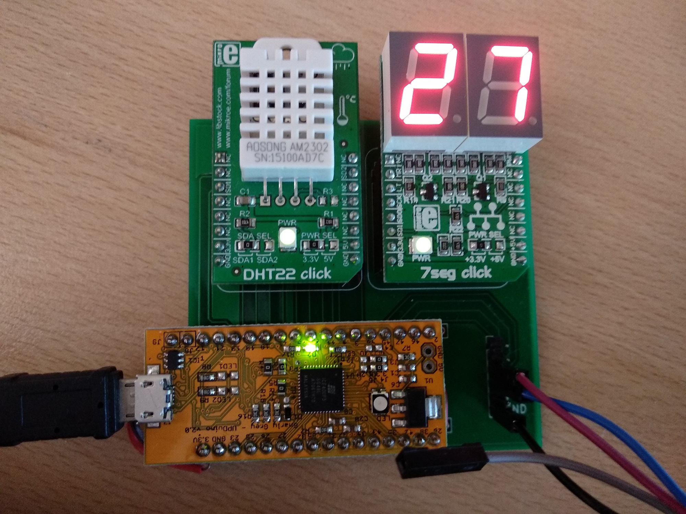
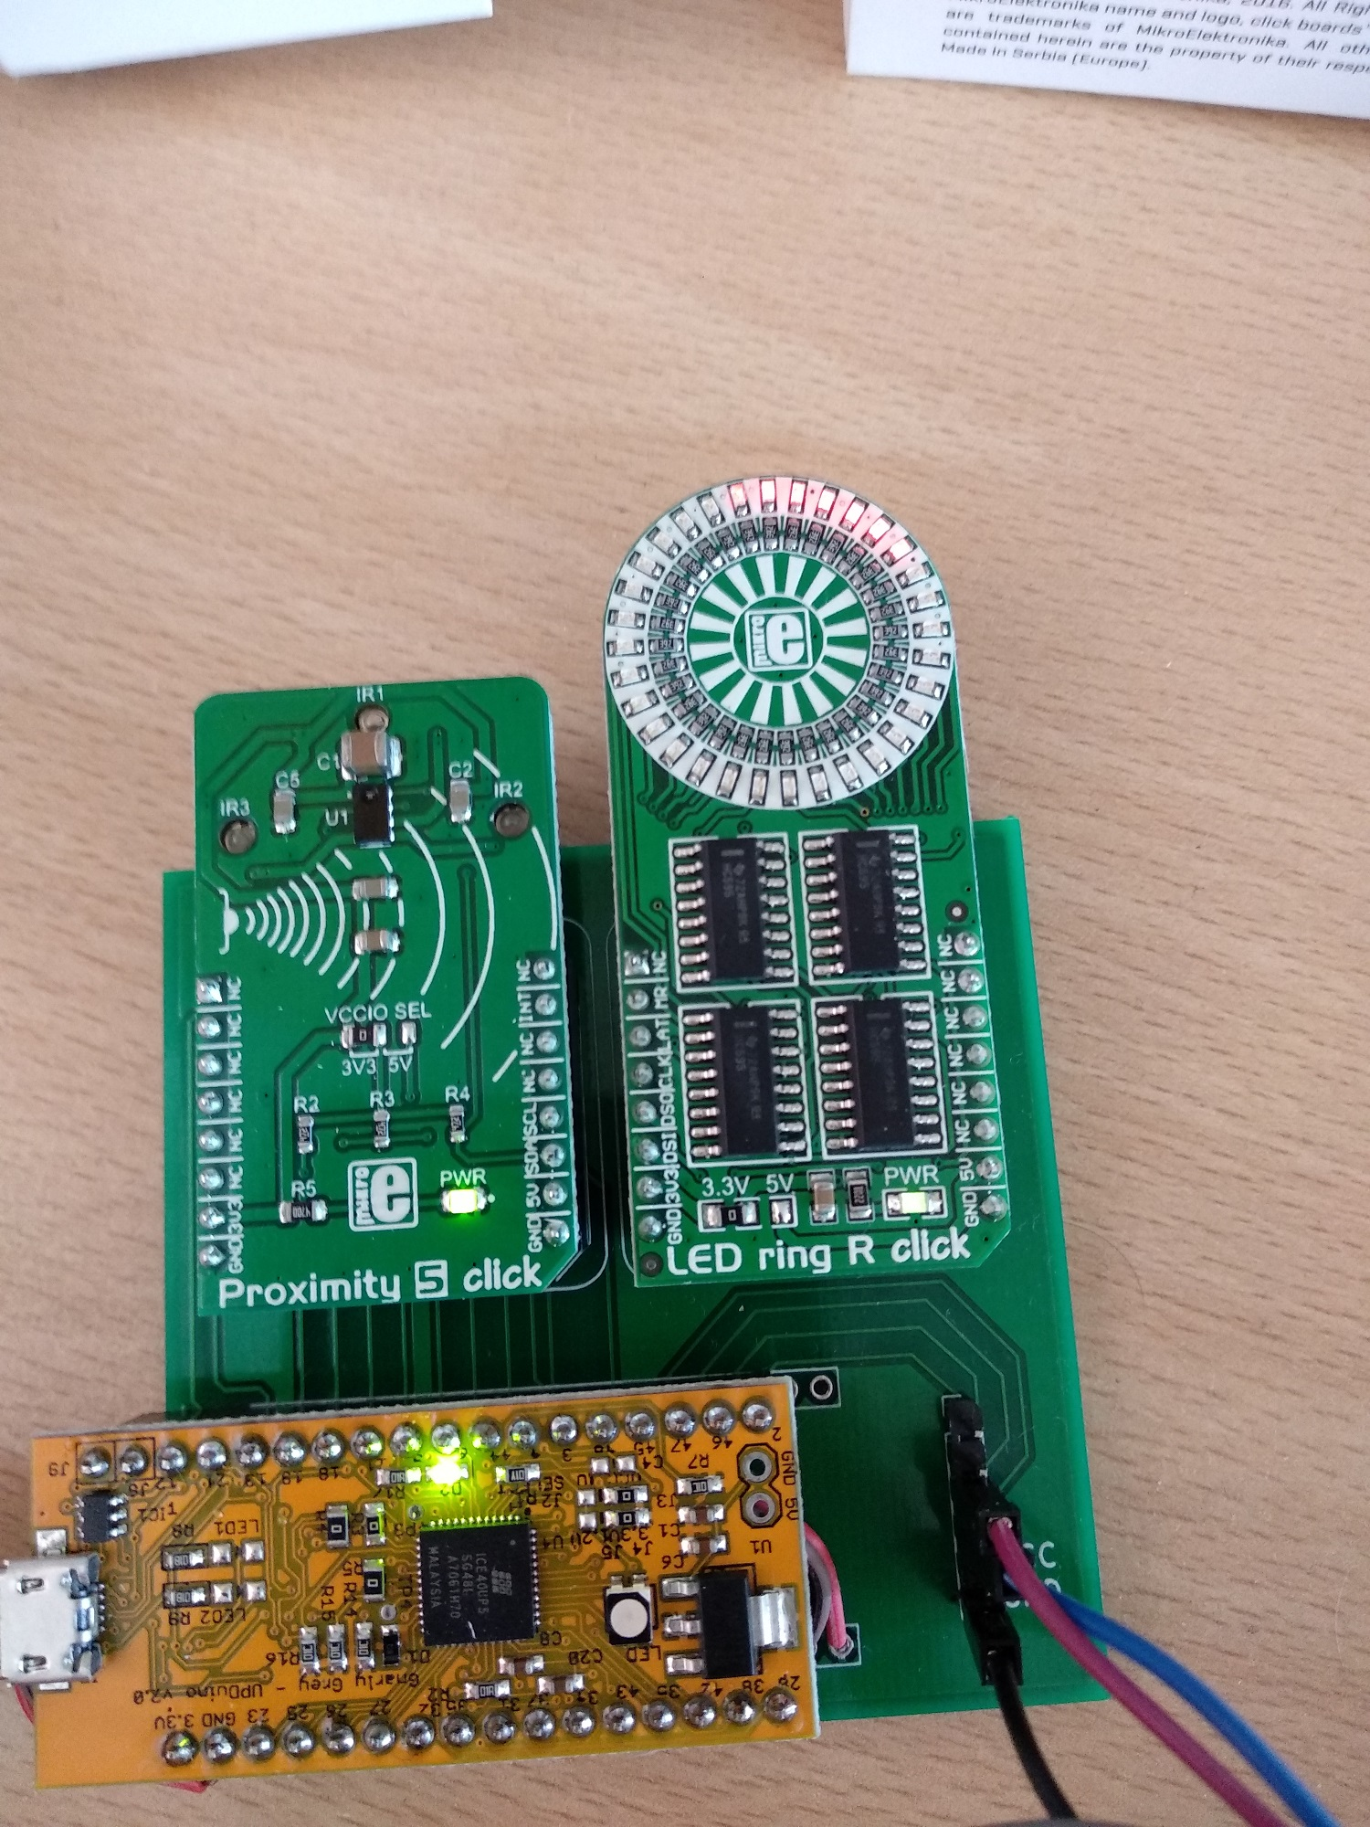
Mikroelektronika
Click boards with FPGA
Order any Click board with provided 20% discount code (valid one month from now)

